Slide 1

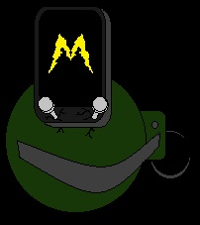
Materializer Progress
Nick Killion, Yaw Asabere,
Victor Dilella, Matt Arbiz

Slide 2
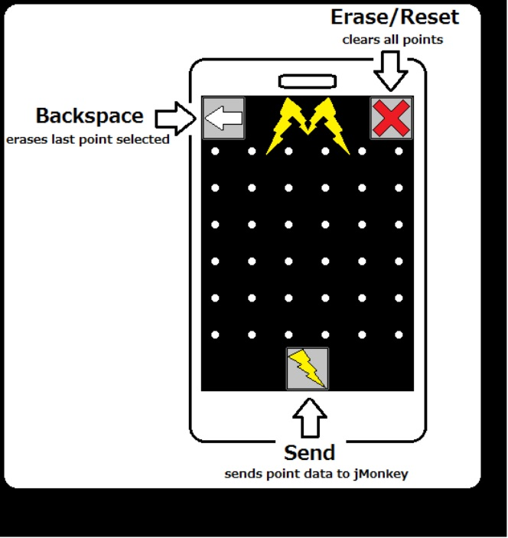

Slide 3
App Function List
Erase()
- erases all selected points
- sets points to false
- clears array
Send()
- sends array of points to jMonkey program
Set_Point()
- sets current point to true
- adds point to array
- draws line (if previous point exists)
Is_Connected()
- if end point equals start point, set to true
- if true, change color of line from red => green

Slide 4
App Function List (cont’d)
Draw_Line()
- draws line on app screen between points
Remove()
- removes last value put in array (if any)
- sets removed point value to false
- erases last line drawn
Check_Point()
- checks boolean value of point

Slide 5
Optimization Functions |***IF TIME PERMITS***|
Overlap()
- if point selected is already set to true, do not add address to array
- if point selected (regardless of boolean value) crosses over a drawn line/selected point => do not add
Is_Corner()
- if selected point is corner and 3 surrounding points are set to true or point would require overlap to continue drawing
=> point is unselectable

Slide 6
Mesh Generator
Example Program

